Slide 1

Therapeutics Potential of Black Turmeric: A Comprehensive Review
Presented by
Shraddha Nana Dhole
B. Pharm Sem VII
PRN No.215450182368
Roll No. 56
K. K. Wagh College of Pharmacy
Guided By
Prof.Dr.P.P.Patil
(Associate Professor)
Department of Pharmacognocy
K.K.Wagh College Of Pharmacy

Slide 2
Introduction :
Plants and the parts of the plants are the main source of the Natural drug products. Since ancient times plants have been used for medicinal purposes. According to the World Health Organization (WHO), over 80% of the world's population uses herbal and natural products as medicinal treatment.[1]
Similarly, Black turmeric (Curcuma caesia Roxb) is a critical medicinal plant belonging to the family Zingiberaceae. The rhizome of black turmeric has very high economic importance because it is very useful in treating several diseases like epilepsy, leprosy, bronchitis, asthma, piles, cancer, fever, wound, impotence, fertility, toothache, vomiting, inflammation .[2,3]
It is aromatic in nature, the rhizome is blackish-blue internally and it has a bitter taste, and pleasant odor and rhizome is very auspicious spiritually in various regions of India.[4]
The plants originate from India and south-east Asia. It is widely distributed all over India.[5]

Slide 3
Aims and Objective:
Aim:
1. To provide a comprehensive review of the current scientific understanding of black turmeric's medicinal properties and uses.
2. To assess the effectiveness and safety of black turmeric as a therapeutic agent for various health conditions.
Objective:
1. To Summarize the chemical composition and pharmacological properties of black turmeric.
2. To provide an overview of black turmeric’s pharmacological characteristics and chemical composition
3. To review existing literature on black turmeric's therapeutic application on various health conditions.

Slide 4
Literature Survey:
Curcuma Caesia Roxb (Black Turmeric)
Botanical Name: Curcuma Caesia roxb
Biological Source: The rhizome obtained from the plant of curcuma caesia roxb.
Family: Zingiberaceae
Appearance:
Rhizome: Dark bluish or blackish color with a strong camphoraceous aroma.
Leaves: Broad, dark green with a purplish underside.
Flowers: Pale yellow or white with a pinkish tinge.
Different Names of Curcuma Caesia roxb:
Kali Haldi (Hindi), (Bengali) Kala Haldi, (Manipuri) Nanga gamba or Yaiku, (Marathi)Kala-halad, (Kannada)Kariarishina, NaruKachora, (Telugu)Nalla Pasupu, (Assamese)Kala Haladhi, (Nepalese)KaaloHaled. [6]

Slide 5
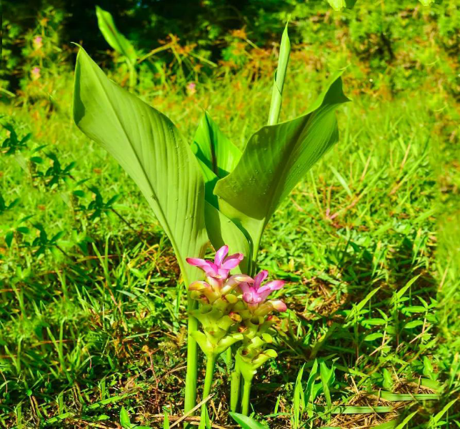
Taxonomic Classification:
Kingdom: Plantae
Subkingdom: Viridiplantae
Phylum: Tracheophyta Sinnott
Subphylum: Euphyllophytes
Class: Magnoliopsida
Order: Zingiberales
Family: Zingiberaceae
Subfamily: Zingiberaceae
Tribe: Hedychieae
Genus: Curcuma
Species: C. Caesia Roxb[6]
Fig 1 Whole Plant of Black Turmeric

Slide 6
Pharamacgosy and Phytochemistry
Morphology
1. Rhizome:
Tuberous, camphor-scented, 2-6 cm in diameter, with unpredictable size and shape.
Sessile, laterally flattened, and covered in warts, root scars, adventitious roots, and longitudinal wrinkles.
Outer surface dark brown, bluish-black, or buff with circular patterns resembling growth rings.
Microscopically, it contains thickened vascular bundles, resin cells, and starch-filled parenchyma.[6]
2. Roots:
Primary roots are absent; propagation occurs via rhizomes.
Long, fibrous, tapering adventitious roots, yellow-brown in color, cover the rhizome surface.[7,8]

Slide 7
3. Leaves:
Grouped in clusters of 10-20, broad, oblong, lanceolate, and glabrous.
Lamina displays purplish shades in the center.
Ivory-colored petioles form a pseudo-axis when unsheathed.
Parallel venation typical of monocots.[7]
4. Inflorescence:
A thick spike, 15-20 cm long, appearing before leaves.
Young bracts are deep red, turning scarlet with age, with some green bracts.[9]
5. Flowers:
Pale yellow with reddish borders, smaller than the bracts.
Calyx: 3-teethed, 10-15 mm long.
Corolla: Tubular, pale yellow, 3-lobed lip, semi-elliptical.

Slide 8
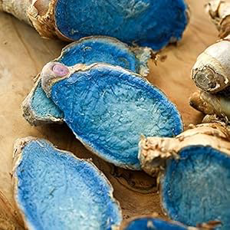
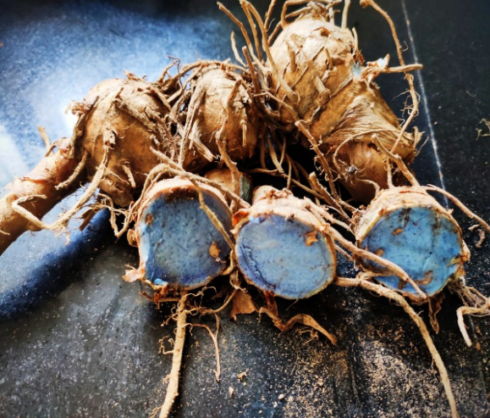
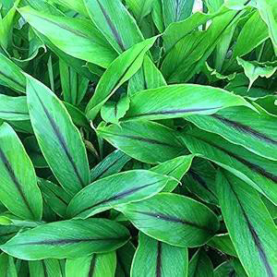
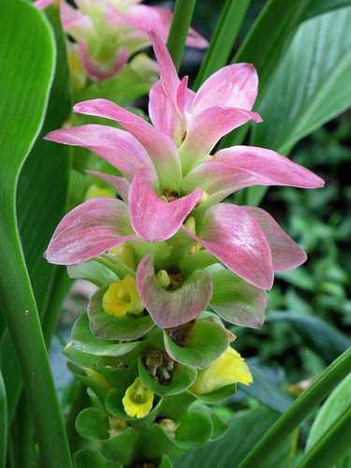
Fig 2 Rhizome of black Turmeric
Fig 3 Roots of Black Turmeric
Fig 4 Leaves of Black Turmeric
Fig 5 Flower of Black Turmeric

Slide 9
Phytochemistry:
Primary Metabolite:
Curcuma caesia Roxb. (Black Turmeric) contains primary metabolites such as carbohydrates, phenols, tannins, alkaloids, flavonoids, cardiac glycosides, and quinones.[10] These metabolites are present in methanolic, aqueous, and chloroform extracts and include additional compounds like phytosterols, terpenoids, diterpenes, starch, glycosides, steroids, resins, and oils[11]
Essential Oil Composition:
1. Rhizome Oils:
South Indian rhizomes: Dominated by 1,8-cineole (30.1%), camphor, ar-curcumene, and camphene.
Central Indian rhizomes: Rich in camphor (28.3%), ar-turmerone, (Z)-β-ocimene, ar-curcumene, and 1,8-cineole.
2. Leaf Oils:
Contains 1,8-cineole (27.0%), camphor (16.8%), and borneol (8.7%).[12,13]

Slide 10
GC-MS Analysis Findings:
Pandey et al: Identified 30 major components in the rhizome, including: Camphor (28.3%), ar-turmerone(12.3%), (Z)-ocimene (8.2%), 1-ar-curcumene (6.8%), 1,8-cineole (5.3%), and borneol (4.4%).
Rastogi et al: Found: Linalool (20.42%), ocimene (15.66%), 1-ar-curcumene (14.84%), zingiberol (12.6%), and 1,8-cineole (9.06%).
Banerjee et al: Reported similar findings with: Linalool (20.42%), ocimene (15.66%), camphor (18.88%), 1-ar-curcumene (14.84%), and α-borneol (7%).[14]
Oil Analysis:
Black turmeric oil major components: Camphor (31.53%), 1,8-cineole (13.33%), curzerene/furanodiene (20.85%), and germa-crone (4.04%).[15]

Slide 11
Pharmacological Activity:
Anti-inflammatory activity: By Paw Edema Method Anti-inflammatory activity was tested using carrageenan-induced paw edema in rats. Inflammation volume was measured using a plethysmometer. The 250 mg/kgBW dose showed the highest anti-inflammatory efficacy.[16] In Late-phase Carrageenan-induced Edema the Methanolic extract (200 mg/kg and 400 mg/kg) significantly reduced paw edema during the late phase (3-5 hours). The reduction is mediated by prostaglandins and leukotrienes.[17] In-vitro study showed the C.Caesia has strong anti-inflammatory activity than the standard sodium diclofenac.[18]
Analgesic Activity: C. Cassia Extract Showed significant analgesic activity in the hot plate test and the acetic acid-induced writhing model in mice. Doses of 200 mg/kg and 400 mg/kg reduced pain.[19] At 100, 200, and 400 mg/kg, it substantially reduced writhing in mice compared to the control group. The analgesic effect was demonstrated in Swiss albino mice using the same models and it Acted as both a central and peripheral analgesic. [20]

Slide 12
3. Locomotor activity and anticonvulsant activity: The methanolic extract of Curcuma (MECC) exhibits a dose-dependent central nervous system (CNS) depressant effect in mice, reducing locomotor activity, which indicates sedation. It also shows anticonvulsant properties by reducing clonic convulsions induced by pentylenetetrazole. MECC causes muscle relaxation, evidenced by reduced grip strength and performance in the rota-rod test, further supporting its CNS-depressant effects. Testing multiple doses is recommended to confirm the dose-dependent effect and determine the most effective dose.[21]
4. Skeletal muscle Relaxant activity:
The study investigates the effects of methanolic extract of black turmeric (Curcuma caesia) on muscle relaxation and calcium-induced contractions.
In-vitro studies: Trachea tissue of guinea pigs pre-contracted with carbachol showed dose-dependent relaxation (50–800 µg/ml). The relaxation was maintained in the presence of various antagonists indicating involvement of multiple pathways. In an Rabbit aorta The extract inhibited calcium-induced contractions at a dose of 30 µg/ml, demonstrating its potential calcium channel-blocking activity.[20]

Slide 13
In-vivo studies: Using a rota-rod apparatus, the extract reduced fall-off time
in mice, indicating muscle relaxation and a calming (neurological deficit) effect.[21]
5. Anxiolytic and CNS depressant Action: For anxiolytic and CNS depressant study the Forced swim test and tail suspension test are carried out. Pentobarbitone induced reduction in onset and prolongation of sleep duration in a dose-dependent manner at a dose of 50 and 100 mg/kg by Methanolic extract of Curcuma caesia roxb. The experiment was carried out for 7 successive days at a dose of 50 and 100 mg/kg and decreased the mobility dose in a dose-dependent manner showing the antidepressant’s activity. [19]
6. Anticancer: The anticancer activity of Curcuma caesia Roxb. is attributed to major components such as β-elemene, β-germacrene, and curzene.[23] Ethanolic rhizome extract showed efficacy against Ehrlich's ascites carcinoma (EAC) in mice by reducing tumor volume, weight, and cell viability while increasing lifespan.[24] The extract's cytotoxic and antioxidant effects decreased oxidative stress, enhanced free radical scavenging, and improved hepatic enzyme levels.[25] In cyclophosphamide-treated mice, pretreatment with methanolic extract reduced micronuclei formation, indicating hepatoprotective and nephroprotective effects, making it suitable as a supplement in chemotherapy.[26]

Slide 14
Hexane extract further demonstrated selective anticancer activity against human liver carcinoma carcinoma cells by inhibiting cell proliferation, arresting the cell cycle at the S and G2/M phases, phase and inducing caspase-3-mediated apoptosis.[27]
7. Antidiabetic Activity: The methanolic extract of Curcuma caesia rhizome demonstrates significant antidiabetic activity, as studied in STZ-induced diabetic rats. The safe dose is established at 2000 mg/kg body weight. It reduces blood glucose levels by inhibiting α-amylase and α-glucosidase enzymes, thereby lowering monosaccharide absorption. STZ-induced diabetes involves β-cell destruction caused by free radicals, leading to reduced insulin production and increased blood glucose levels.[28] In vitro studies reveal that the ethyl acetate fraction shows potent α-amylase inhibition ,outperforming standard curcumin and camphor. Compounds like eucalyptol, camphor, germacrone, caryophyllene, and β-sitosterol were identified as contributors to the antidiabetic activity.[29]
8. Antioxidant Activity:
Essential Oil: Displays high antioxidant activity, with an IC50 of 48.08 µg/mL, comparable to ascorbic acid.[18]
Ethanolic Extract: Contains free radical scavenging properties, total phenolics, and reducing abilities. It shows dose-dependent inhibition of DPPH, along with scavenging of peroxynitrite, nitric oxide, superoxide, and hydroxyl radicals.[32]

Slide 15
Enzymatic and Crude Extracts: The enzymatic extract includes antioxidants like peroxidase, glutathione peroxidase, catalase, and superoxide dismutase. However, the non-enzymatic crude extract exhibits greater antioxidant potential.[33]
Methanolic Extract: Outperforms standard butylated hydroxytoluene in antioxidant activity. It scavenges 50% of the DPPH solution and shows reduced absorbance with increasing concentration.[34]
Comparison with C. amada: C. caesia has superior antioxidant activity, attributed to its higher phenolic content[35]
9. Antimicrobial Activity:
9.1. Antibacterial activity:
Broad-spectrum Activity: Effective against both Gram-positive and Gram-negative bacteria, including Staphylococcus aureus (highest inhibition), Escherichia coli, Pseudomonas aeruginosa, Staphylococcus epidermidis, Streptococcus mutans, Proteus vulgaris, and Klebsiella pneumoniae. Effective against drug-resistant bacteria such as Mycobacterium tuberculosis (Mtb H37Rv) and multidrug-resistant (MDR) clinical strains of Mtb.[37]
2 . Extract-specific Findings: Ethanolic Extract: Active against Bacillus spp., Salmonella typhi, Vibrio cholera, S. aureus, Streptococcus pyogenes, E. coli, and Pseudomonas aeruginosa.

Slide 16

Hexane Extract: Targets Streptococcus haemolyticus and Bacillus cereus[39]
Chloroform Extract: Effective against Bacillus cereus.
Ethyl Acetate Extract: Active against Staphylococcus aureus.
Acetone Extract: Inhibits S. aureus, Streptococcus haemolyticus, and Bacillus cereus
Essential Oil: Active against Bacillus subtilis, Bacillus cereus, S. aureus, and Salmonella typhimurium, with the lowest MIC (2.5 µL) against S. aureus.
3. Solvent-dependent Effectiveness: Root extracts are more effective than stem or leaf extracts. Solvents used include aqueous, methanol (polar), chloroform (non-polar), and acetone (dipolar)[40]
9.2. Antifungal Activity:
Essential Oil and Ethanolic Extracts: Show antifungal activity against Aspergillus flavus, Aspergillus fumigatus, Aspergillus niger, Candida albicans, and Saccharomyces cerevisiae.[43,44] The isolated terpenoid compound (Z)-7-methoxy-1,5-dihydrobenzo[c]oxepine exhibits activity against Fusarium oxysporum, Botrytis cinerea, Rhizopus oryzae, Candida albicans, and Candida glabrata.[45]

Slide 17
Diethyl Ether Extracts: C. caesia and Ixora coccinea, show antifungal activity against Botrytis cinerea.
Broad Antifungal Activity: Effective against several species, including Alternaria alternata, Curvularia lunata, Fusarium equiseti, Macrophomina phaseolina, Botryodiplodia theobromae, and Colletotrichum corchori.[38]
10.Thrombolytic Activity:
Curcuma Caesia Extract: Shows clot lysis of 49.18±3.41%, compared to the positive control (streptokinase) at 71.54±3.26% and the negative control (water) at 2.96±0.28%. This suggests potential use in treating ischemic myocardium or thromboembolic disorders.[47]
Comparison with C. amada: C. caesia (38.75%) shows slightly higher thrombolytic activity than C. amada (34.74%). [47]
Silver Nanoparticles: C. caesia silver nanoparticles exhibit higher thrombolytic activity than those of C. amada.[48]

Slide 18
Conclusion
Curcuma Caesia roxb is the untouched drug currently gaining popularity due to its health benefits. The rhizome of black turmeric has potential health benefits. In India traditionally black turmeric is used to treat leprosy, asthma, toothache, and vomiting. It contains camphor, ar-turmerone, (z)-Ocimene, ar-curcumene, 1,8-cineole, elemene, borneol, bornyl acetate, and curcumene which give the pharmacological activity. Black turmeric shows anticonvulsant, anti-inflammatory, antidiabetic antioxidant, antibacterial, antifungal, skeletal muscle relaxant, and analgesic activity. Furthermore, detailed scientific and clinical studies are needed to explore the medicinal benefits of black turmeric and other parts of plant leaves, stems, and flowers.

Slide 19
Future Perspective:
This plant extract has shown some improvement in bronchial asthma, tumour control, and allergy. It has also demonstrated anti-inflammatory, anticancer and antimicrobial properties and is being extensively researched for use in medicaments which aim at treating asthma, cancer and allergy among other disorders. People are looking for better alternatives and demand for natural ingredients is growing. Black turmeric can also be frequently used in food and in cosmetics as well as in the textile industries. For instance, due to its purifying properties, it can serve as a natural dye and preservative to suit the surge in demand for environmentally friendly products. With the growing commercialization of black turmeric, there is need to maintain scientific practices so as to enhance yields and preserve this endangered species. Though still under laboratory evaluation, tissue culture among other techniques can help develop black turmeric at a large scale in a sustainable way. Areas such as India, black turmeric can be regarded culturally important and stand economic benefits for farmers as well. Increased market participation and better farming practices may facilitate better opportunities in livelihoods especially in the rural setups.

Slide 20
References:
1. Ibrahim NNA, Wan Mustapha WA, Sofian-Seng NS, Lim SJ, Mohd Razali NS, Teh AH, et al. A Comprehensive Review with Future Prospects on the Medicinal Properties and Biological Activities of Curcuma caesia Roxb . Russo D, editor. Evid Based Complement Alternat Med. 2023 Jan;2023(1):7006565.
2. Bhupendra Sahu, Rameshroo Kenwat, Shashikant Chandrakar. Medicinal Value of Curcuma cassia roxb: An Overview. Pharm Biosci J. 2016 Dec 22;69–74.
3. Khare S.P. Indian medicinal plants: an illustrated dictionary. Springer Science & Business Media. 2008.
4. Venugopal A. MEDICINAL PROPERTIES OF BLACK TURMERIC: A REVIEW. 2017;4(3).
5. Sharma DA, Singh DJ, Sharma MS, Kumar MA, Singh MD. TREASURE OF MEDICINAL VALUE- BLACK TURMERIC. Des Eng. 2021;(8).
6. Violina Kalita PP, Purbajit Chetia. A Review on Phramacological Properties of Curcuma caesia Roxb. Int J Pharm Pharm Res. 2018 Mar;11(4).

Slide 21
7.Baghel R, Sharma K, Sikarwar I. Pharmacological activities of Curcuma caesia. Int J Green Pharm. 2013;7(1):1.
8. Borah A, Kumar D, Paw M, Begum T, Lal M. A review on ethnobotany and promising pharmacological aspects of an endangered medicinal plant, Curcuma caesia Roxb. Turk J Bot. 2020 Apr 6;44(3):205–13.
9. Paliwal P, Pancholi S, Patel R. Pharmacognostic parameters for evaluation of the rhizomes of Curcuma caesia. J Adv Pharm Technol Res. 2011;2(1):56.
10. Donipati P, Sreeramulu SH. Preliminary Phytochemical Screening of Curcuma caesia. 2015;
11. Pandey S, Pandey S, Mishra M, Tiwari P. Morphological, phytochemical, and pharmacological investigation of Black Turmeric (Curcuma caesia Roxb.). 2022;13(2).
12. Dosoky NS, Setzer WN. Chemical Composition and Biological Activities of Essential Oils of Curcuma Species. Nutrients. 2018 Sep 1;10(9):1196.
13. Behura S, Srivastava VK. Essential Oils of Leaves of Curcuma Species. J Essent Oil Res. 2004 Mar;16(2):109–10

Slide 22
13. Behura S, Srivastava VK. Essential Oils of Leaves of Curcuma Species. J Essent Oil Res. 2004 Res.2004Mar;16(2):109–10.
14. Das, S., Mondal, P., & Zaman, Md. K. (2013). CURCUMA CAESIA ROXB. AND IT’S MEDICINAL USES: A REVIEW. International Journal of Research in Pharmacy and Chemistry, 3, 370–371
15. Mahanta BP, Kemprai P, Bora PK, Lal M, Haldar S. Phytotoxic essential oil from black turmeric (Curcuma caesia Roxb.) rhizome: Screening, efficacy, chemical basis, uptake and mode of transport. Ind Crops Prod. 2022 Jun;180:114788.
16. Sawant SB, Bihani G, Mohod S, Bodhankar S. EVALUATION OF ANALGESIC AND ANTI-INFLAMMATORY ACTIVITY OF METHANOLIC EXTRACT OF CURCUMA CAESIA ROXB. RHIZOMES IN LABORATORY ANIMALS. 6(2).
17. Udayani NNW, Nida AY. The Anti-Inflammatory Activity Of The Black Turmeric (Curcuma Caesia Roxb.) Ethanol Extract In Carrageenan Induced Male Wistar Stream Rats. Neuro Quantology. 2022;20(9).
18. Borah A, Paw M, Gogoi R, Loying R, Sarma N, Munda S, et al. Chemical composition, antioxidant, anti-inflammatory, anti-microbial and in-vitro cytotoxic efficacy of essential oil of Curcuma caesia Roxb. leaves: An endangered medicinal plant of North East India. Ind Crops Prod. 2019 Mar;129:448–54.

Slide 23
19.Karmakar I, Saha P, Sarkar N, Bhattacharya S, Haldar PK. Neuropharmacological assessment of Curcuma caesia rhizome in experimental animal models. Orient Pharm Exp Med. 2011 Dec;11(4):251–5.
20. Arulmozhi DK, Sridhar N, Veeranjaneyulu A, Arora SK. Preliminary Mechanistic Studies on the Smooth Muscle Relaxant Effect of Hydroalcoholic Extract of Curcuma caesia. J Herb Pharmacother. 2007 Jan 30;6(3):117–24.
21. Preliminary Investigation of Pharmacological Activities of Curcuma caesia Methanol Extracts. (2015). In INTERNATIONAL JOURNAL OF PHARMACY & LIFE SCIENCES (Vols. 6–6, pp. 4551–4556)
22. Karmakar I, Saha P, Sarkar N, Bhattacharya S, Haldar PK. Neuropharmacological assessment of Curcuma caesia rhizome in experimental animal models. Orient Pharm Exp Med. 2011 Dec;11(4):251–5.
23. Gusti Ayu Mayani Kristina Dewi. NLS, Ni G. A. ME, Ting Seng Ho SR. Toxicity Test of Black Turmeric Extract (Curcuma caesia Roxb.) on Artemia salina Larva and Its Potential as an Anti-Cancer Agent. East J Agric Biol Sci. 4(1).
24. Karmakar I, Dolai N, Suresh Kumar RB, Kar B, Roy SN, Haldar PK. Antitumor activity and antioxidant property of Curcuma caesia against Ehrlich’s ascites carcinoma bearing mice. Pharm Biol. 2013 Jun;51(6):753–9.

Slide 24
25. Kma L, Sharan R, Hadem KL. Inhibitory potential of methanolic extracts of Aristolochia tagala tagala and Curcuma caesia on hepatocellular carcinoma induced by diethylnitrosamine in BALB/c mice. J Carcinog. 2014;13(1):7.
26. Devi H, Mazumder P. Methanolic Extract of Curcuma caesia Roxb. prevents the toxicity caused by Cyclophosphamide to bone marrow cells, liver and kidney of mice. Pharmacogn Res. 2016;8(1):43.
27. Mukunthan KS, Satyan RS, Patel TN. Pharmacological evaluation of phytochemicals from South Indian Black Turmeric (Curcuma caesia Roxb.) to target cancer apoptosis. J Ethnopharmacol. 2017 Sep;209:82–90.
28. Majumder P, Mazumder S, Chakraborty M, Chowdhury SG, Karmakar S, Haldar PK. Preclinical evaluation of Kali Haldi (Curcuma caesia): a promising herb to treat type-2 diabetes. Orient Pharm Exp Med. 2017 Jun;17(2):161–9.
29. Jain A PD. In-vitro antidiabetic potential of endangered Curcuma caesia rhizome extracts and its characterization by FTIR and GC/HR-MS analysis. Int J Adv Sci Eng Technol.
30. Devi HP, Mazumder PB, Devi LP. Antioxidant and antimutagenic activity of Curcuma caesia Roxb. rhizome extracts. Toxicol Rep. 2015;2:423–8.
31. Sahu R, Saxena J. Screening of Total Phenolic and Flavonoid Content in Conventional and Non-Conventional Species of Curcuma.

Slide 25
32.Karmakar I, Dolai N, Saha P, Sarkar N, Bala A, Haldar PK. Scavenging activity of Curcuma caesia rhizome against reactive oxygen and nitrogen species. Orient Pharm Exp Med. 2011 Dec;11(4):221–8.
33. Dhal Y, Deo B, Sahu RK. COMPARATIVE ANTIOXIDANT ACTIVITY OF NON-ENZYMATIC AND ENZYMATIC EXTRACTS OF CURCUMA ZEDOARIA, CURCUMA ANGUSTIFOLIA AND CURCUMA CAESIA.
34. Mangla, M., Shuaib, M., Jain, J., & Mangla, M. (2010). In-vitro evaluation of antioxidant activity of Curcuma caesia Roxb [Research Article]. International Journal of Pharmaceutical Sciences and Research, 9–Suppl., 98–102.
35. Reenu J, Azeez S, Bhageerathy C. In vitro antioxidant potential in sequential extracts of Curcuma caesia roxb. rhizomes. Indian J Pharm Sci. 2015;77(1):41.
36. Krishnaraj M, Manibhushanrao K, Mathivanan N. A comparative study of phenol content and antioxidant activity between non-conventional Curcuma caesia Roxb. and Curcuma amada Roxb.
37. Siti Juariah, Fazleen Izzany Abu Bakar, Mohd Fadzelly Abu Bakar, Susi Endrini. Antibacterial potential of Curcuma caesia Roxb ethanol extract against nosocomial infections. Bali Med J. 2023 Jun 21;12(2):1959–63.

Slide 26
38. Chowdhury Z, Islam MS, Hoque MR, Chowdhury AMA, Bhuiyan RH, Alauddin M. Antibacterial and antifungal activity of ethanol extract of Curcuma casiea. Chittagong Univ J Biol Sci. 2013 Jan 18;149–54.
39. Thomas Td, Jose S. Comparative phytochemical and anti-bacterial studies of two indigenous medicinal plants Curcuma caesia Roxb. and Curcuma aeruginosa Roxb. Int J Green Pharm. 2014;8(1):65.
40. Pandey, D. G AK. ANTIBACTERIAL EFFICACY OF CURCUMA CAESIA FROM BASTAR DISTRICT OF CHHATTISGARH, INDIA. Nternational J Pharm Sci Res.
41. Gupta VK, Kaushik A, Chauhan DS, Ahirwar RK, Sharma S, Bisht D. Anti-mycobacterial activity of some medicinal plants used traditionally by tribes from Madhya Pradesh, India for treating tuberculosis related symptoms. J Ethnopharmacol. 2018 Dec;227:113–20.
42. Kaur R, Kaur B, Suttee A, Kalsi V. COMPARATIVE ASSESSMENT OF IN VITRO ANTIMICROBIAL ACTIVITY OF CURCUMA CAESIA ROXB. AND CURCUMA AMADA ROXB. Asian J Pharm Clin Res. 2018 Jul 27;11(14):94.
43. Harit J, Barapatre A, Prajapati M, Aadil KR, Senapati S. ANTIMICROBIAL ACTIVITY OF RHIZOME OF SELECTED CURCUMA VARIETY. Pharm Res. 2013;

Slide 27
44. Ghosh A. Bioformulation of antifungal herbal extract from Curcuma caesia Roxb. and Ixora coccinea L. against Botrytis cinerea Pers. J Phytopharm. 2018;56–9.
45. Ghosh, A., C P. Evaluation of Antimicrobial and Antifungal potential of (Z)-7-methoxy-1, 5-dihydrobenzo[c] oxepine, isolated from Curcuma caesia Roxb. J Sci Innov Res. 2013;745–50.
46. Dineja, R., Savithri, S., Rajkumar, K., Bose, D., & Vasanthi, V. Evaluation of an Antifungal Property of Curcuma caesia a Traditional Herb against Candida Species: An In vitro Study. J Nat Sci Med. 2023;6(2):206–9.
47. Fathima, N., Syeda Nishat Fathima, Ahmad, V., & Kumar, R. Evaluation of In Vitro Thrombolytic Activity of Ethanolic Extract of CURCUMA CAESIA Rhizomes. Int J Pharma Res Rev. 2015;4(11):50–4.
48. Saravana Sankar VB, V A, Ahmad A, Tajo SM. THROMBOLYTIC ACTIVITY OF C.AMADA AND C.CAESIA. Asian J Pharm Clin Res. 2017 Feb 1;10(2):317.

Slide 28
Thank You!

